Slide 1
Topic
Introduction to Neural Networks

Slide 2
Concepts Covered:
Biological and Artificial Neurons
Artificial Neural Networks
Supervised and Un-supervised Learning
Incremental and Batch modes of Training

Slide 3
Introduction to Neural Networks
Proposed by McCulloh and Pitts, 1943
Biological nervous system consists of a large number of interconnected processing units called neurons operating in parallel
Human brain contains approximately 10¹¹ neurons. Our brain is a highly complex parallel computer

Slide 4
Biological Neuron
Consists of dendrites (a bush of thin fibers); cell body (also known as soma); axon (a long cylindrical fiber), synapse; and others

Slide 5
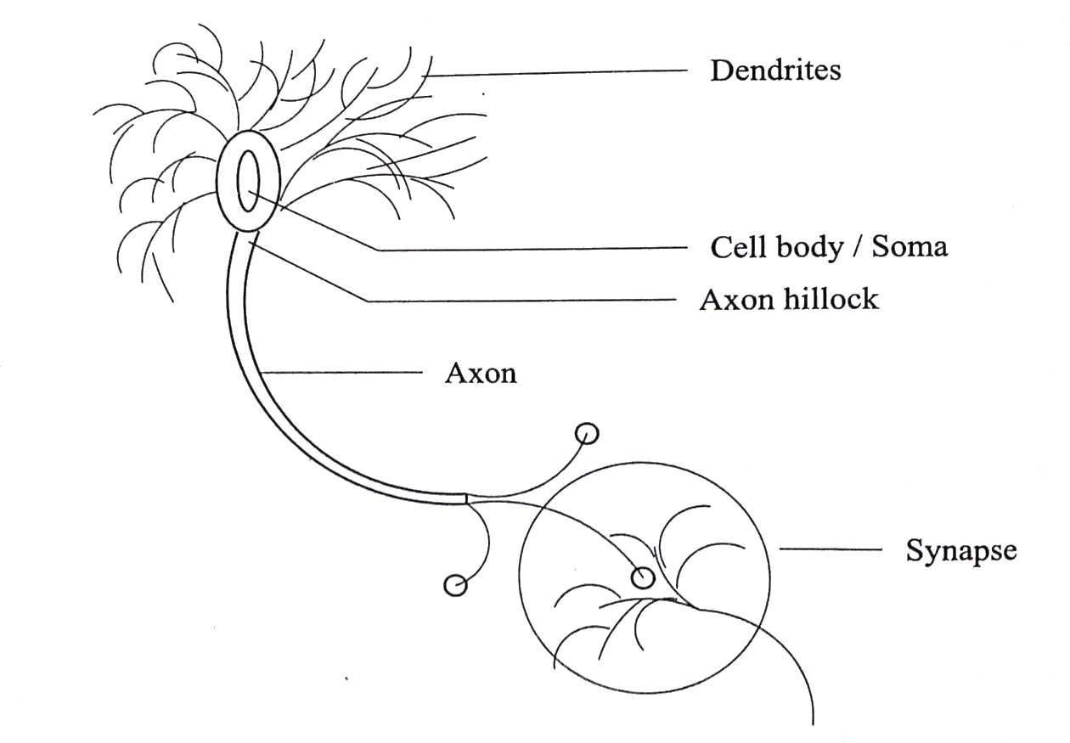
A schematic view showing a biological neuron.

Slide 6
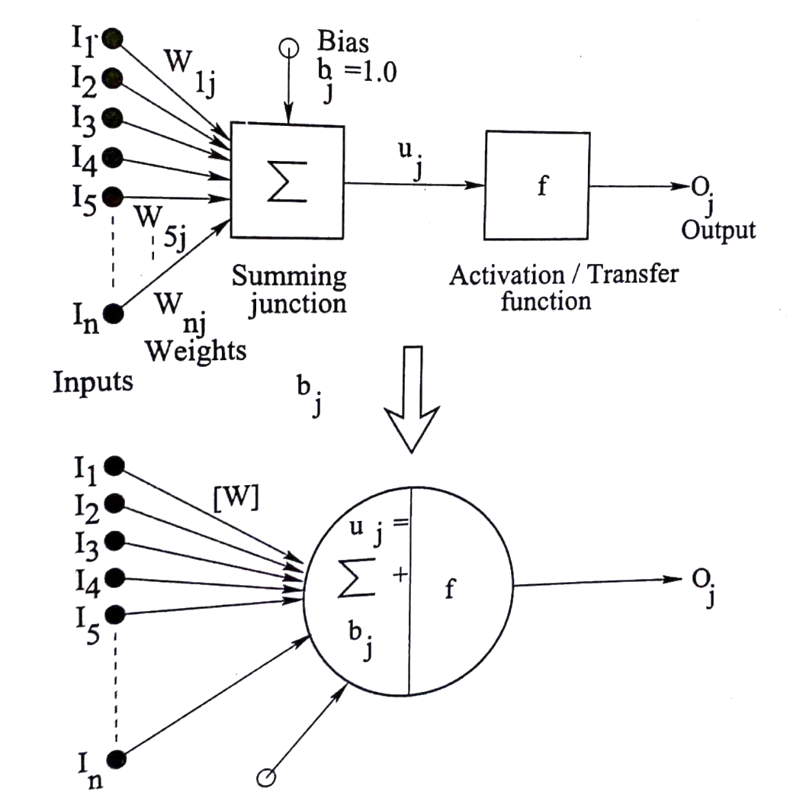
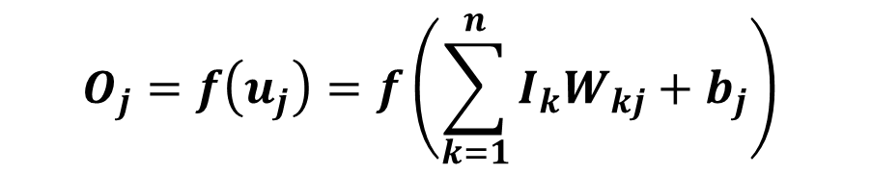
Artificial Neuron:
$$O_{j}=f\left(u_{j}\right)=f\left(\sum_{k=1}^{n}{I_{k}W_{kj}+b_{j}}\right)$$

Slide 7
Types of transfer functions
Hard-limit
Linear
Log-sigmoid
Tan-sigmoid, and others

Slide 8
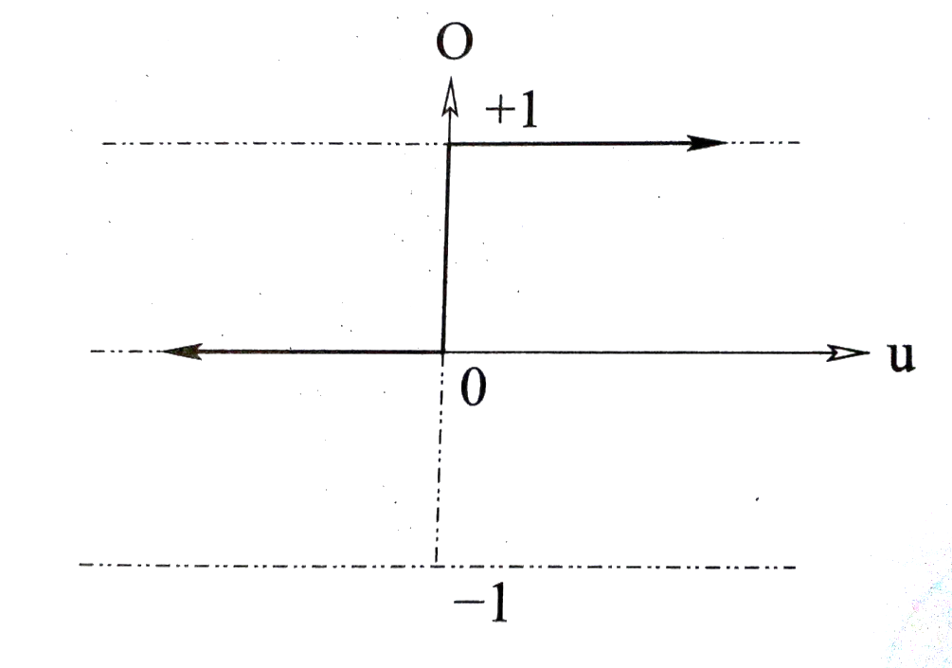
Transfer functions
Hard-limit TF:
O = 0.0, if u < 0.0
1.0, otherwise

Slide 9
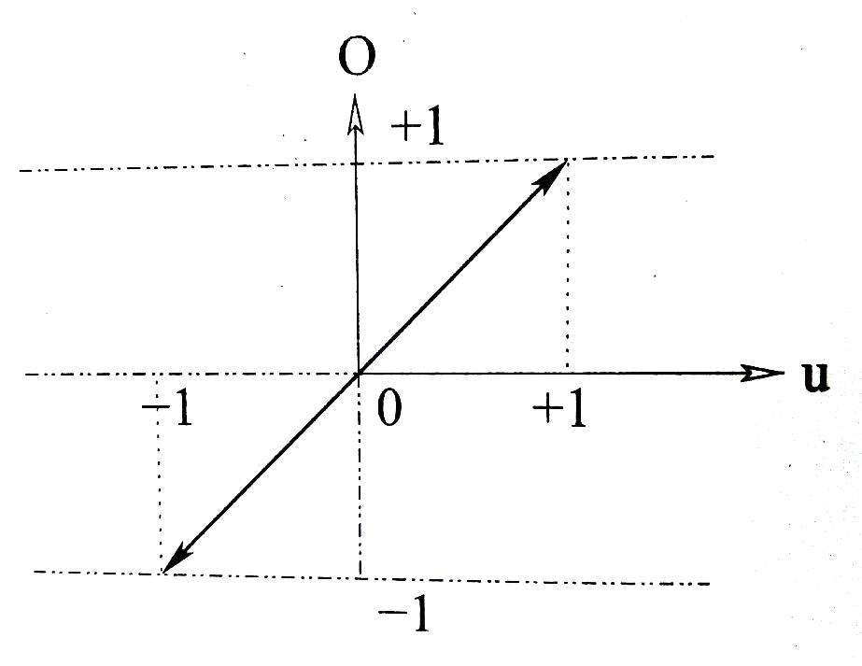
Linear TF:
O = u

Slide 10
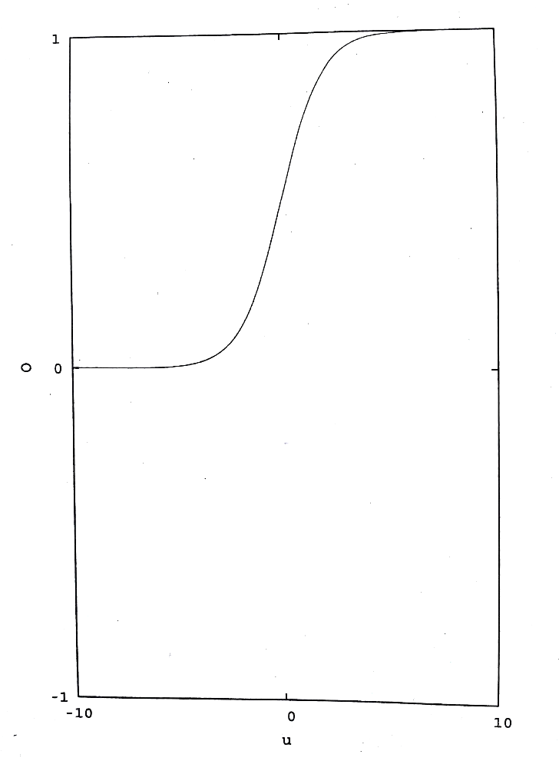

Log-Sigmoid TF:
$$O=\frac{1}{1+e^{−au}}$$

Slide 11
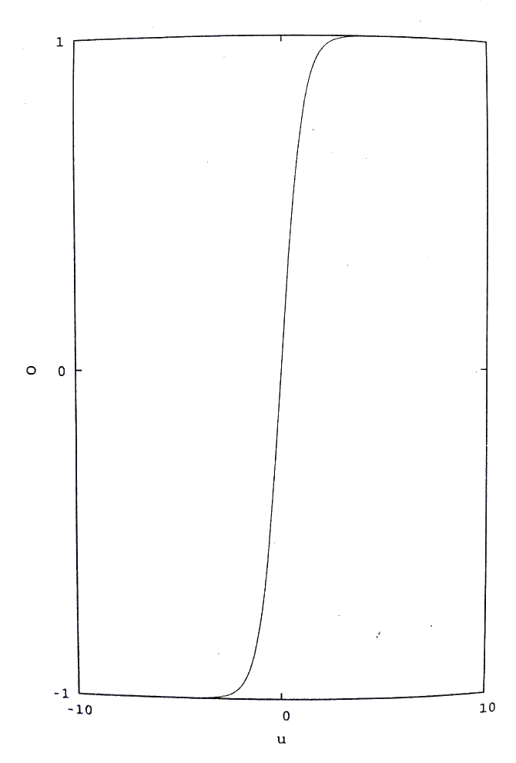
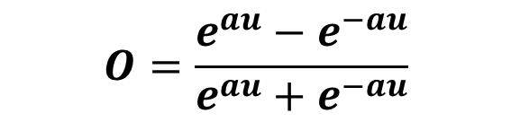
Tan-Sigmoid TF:
$$O=\frac{e^{au}−e^{−au}}{e^{au}+e^{−au}}$$

Slide 12
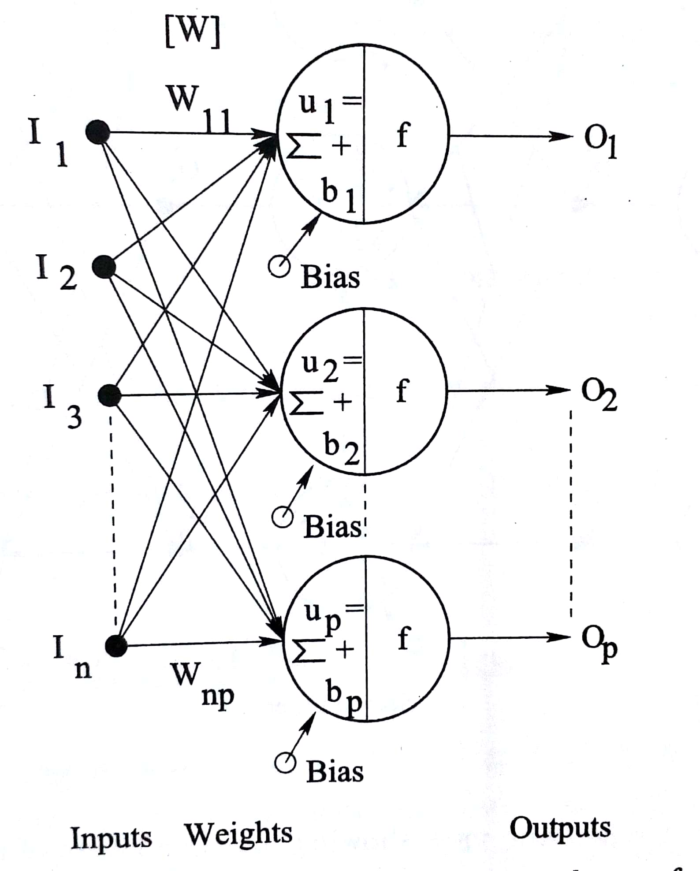
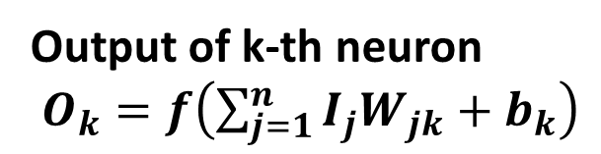
One layer of Neurons:
[W] = W₁₁ W₁₂ . . . . . . W_{1p}
W₂₁ W₂₂ . . . . . . W_{2p}
. . .
. . .
W_{n1} W_{n2} . . . . . . W_{np}
Output of k-th neuron
$O_{k}=f\left(\sum_{j=1}^{n}{I_{j}W_{jk}+b_{k}}\right)$

Slide 13
Multiple Layers of Neurons (Artificial Neural Network)
b
2-3-1 Network
I₁, I₂ :Inputs
b: Bias value
[V], [W]: Connecting weights
O : Output
[V]
b
1
[W]
I₁
b
1
2
1
O
I₂
2
3
Input
Layer
Hidden
Layer
Output
Layer

Slide 14
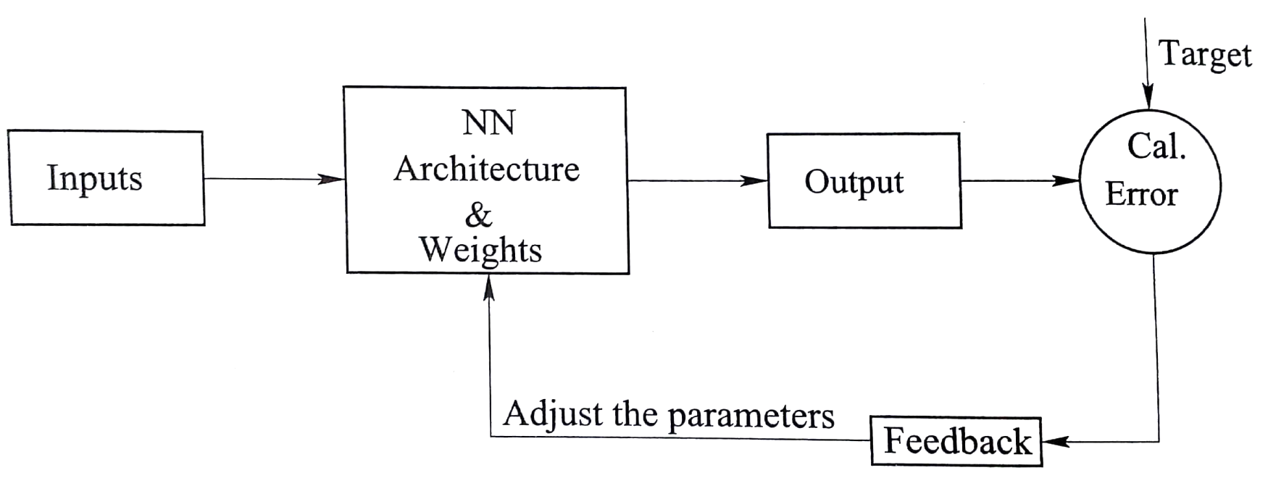
Static vs. Dynamic Neural Networks
Static NN: No error compensation
Dynamic NN: Error is fed back to the network to modify its architecture and update the weights.

Slide 15
Training of Neural Networks
Supervised Learning / Learning with Teacher
The outputs of the network are compared with the corresponding target values and the error is calculated. It is then fed back to the network for updating of the same.
Un-Supervised Learning / Learning without Teacher
Competition, cooperation and updating

Slide 16
Incremental vs. Batch Modes of Training
Incremental Training / On-line Training:
A particular training scenario is passed through the network, output(s) is/are calculated and then error is determined by comparing it/them with the target(s). The error is propagated to modify the network

Slide 17
Incremental vs. Batch Modes of Training (cont.)
Batch Mode of Training / Off-line Training:
The whole training set consisting of a large number of scenarios, is passed through the network and an average error in predictions is determined. The network will be updated based on this average error.

Slide 18
Conclusion:
Structure of Artificial Neural Network has been explained
Principle of Supervised and Un-supervised Learning has been discussed
Incremental and Batch modes of training have been defined

